Slide 1
Magrathea

Slide 2
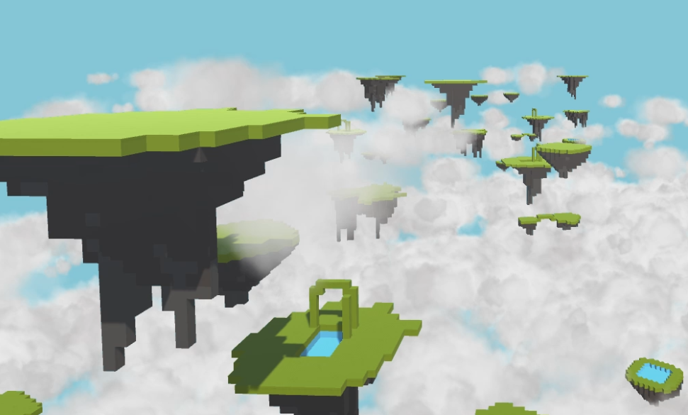
Original Design
Dark Fox Project gave us original brief
We moved towards world creation technology
Inspired by the experiment to see if the universe was a simulation
Got the name from Hitchhikers
There were many different interpretations

Slide 3
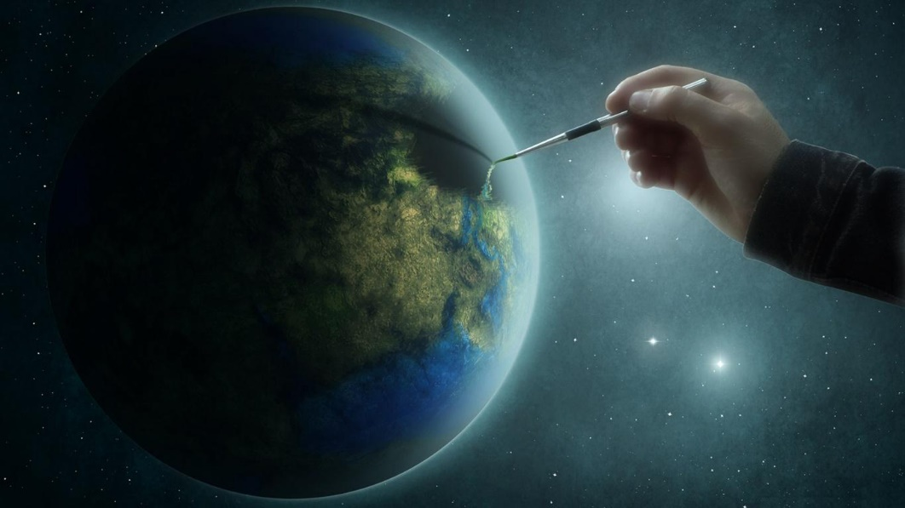
Was this suitable?
This was a suitable brief for a future company
Perhaps world building was too futuristic
This led us towards constraining the brief
Eventually evolved to suit the needs of the project

Slide 4
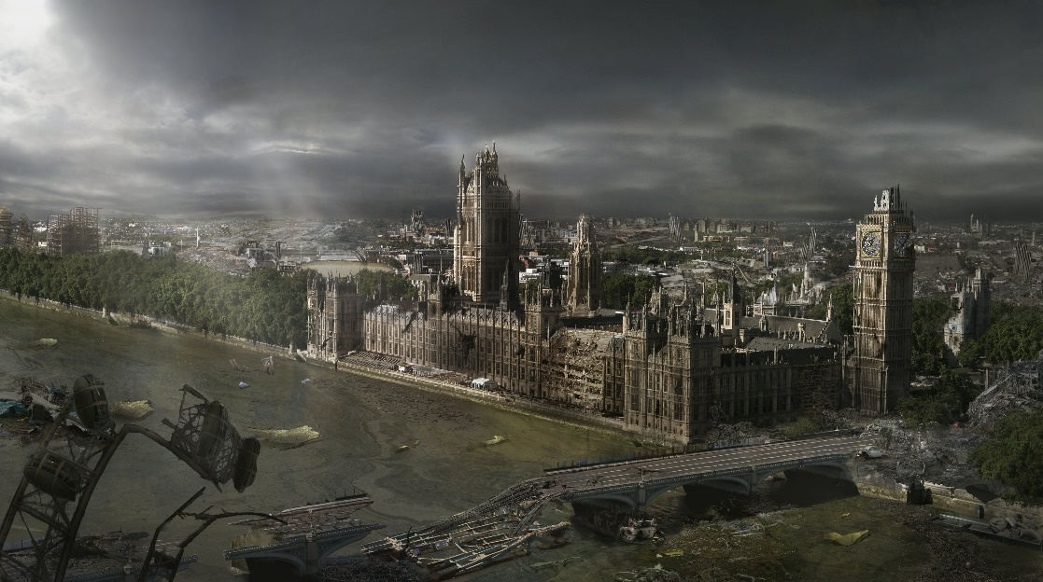
How it changed
The project then moved towards VR
Decided the world will be apocalyptic
In order to escape, people use VR
This was adjusted to include the Dark Fox Project
The overall theme of the dark and depressing world remained

Slide 5
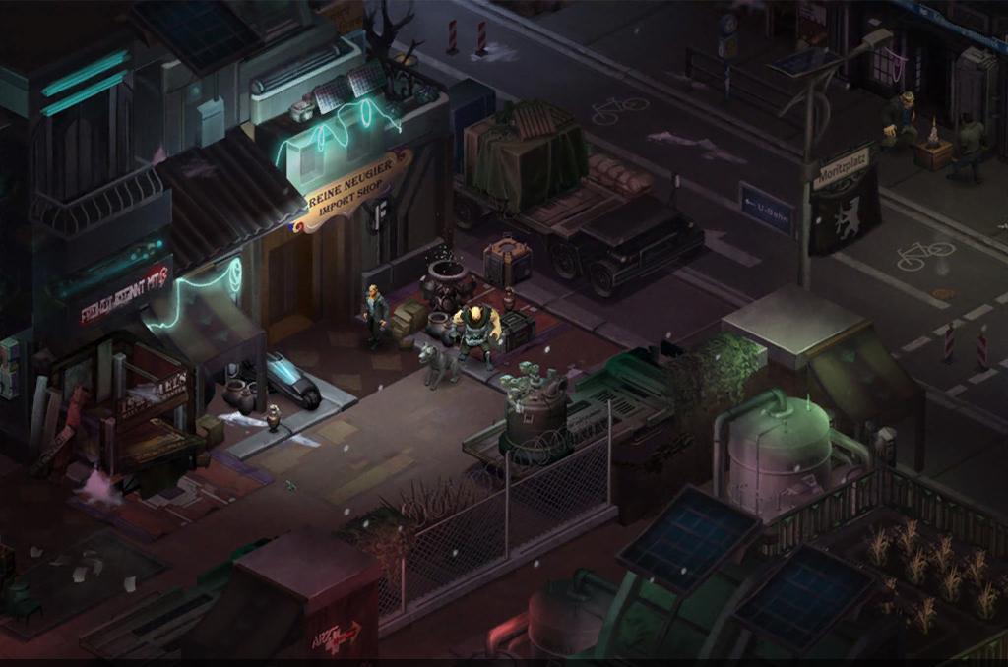
Future marketplace
This project would be suitable for the world we envision
Pretty much the same as ‘Ready Player One’
This would have a large client base of regular use
Initial aesthetics and world inspired by Shadowrun

Slide 6
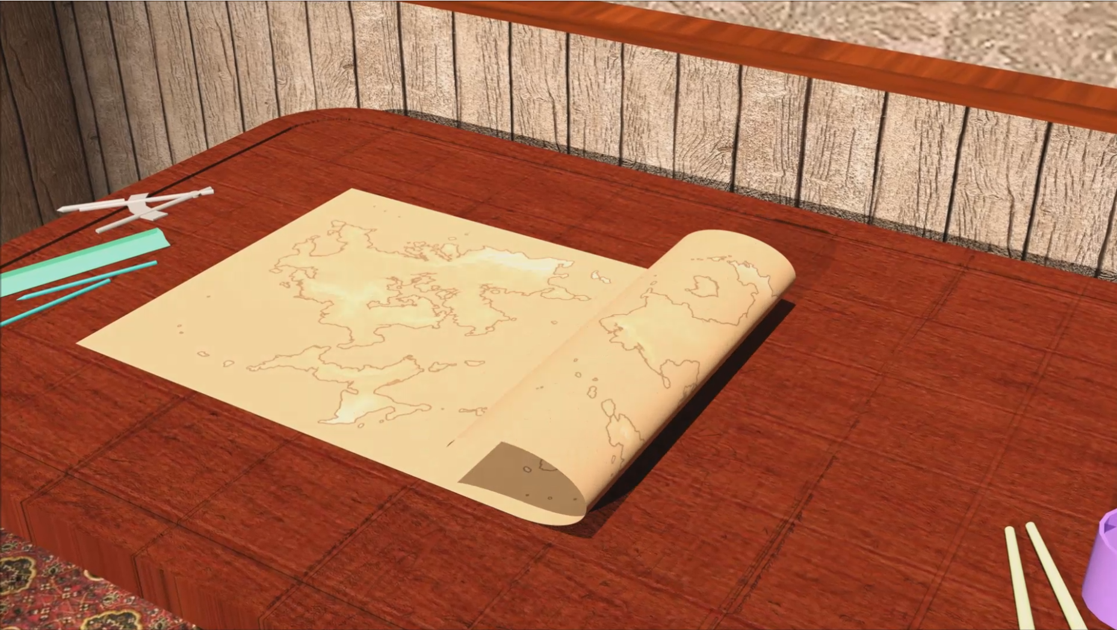
Coursework reflection
The ident was initially designed to show off the company theme
The trailer was then made to compliment it and show off the worlds
We encountered some editing issues, as well as issues with sound design
Mainly team dynamic issues

Slide 7

Team Dynamic
We didn’t have visuals until after Christmas
Communications during Christmas resulted in improvisation
The project changed dramatically because of this
We did keep to schedule and we did work well after our initial problems

Slide 8

How our skills were utilised
Coding skills to create a camera rig for Unity
Animation and modelling skills to animate in Source
Modelling skills were used to create meshes and models
Editing skills were also used to create a polished trailer

Slide 9
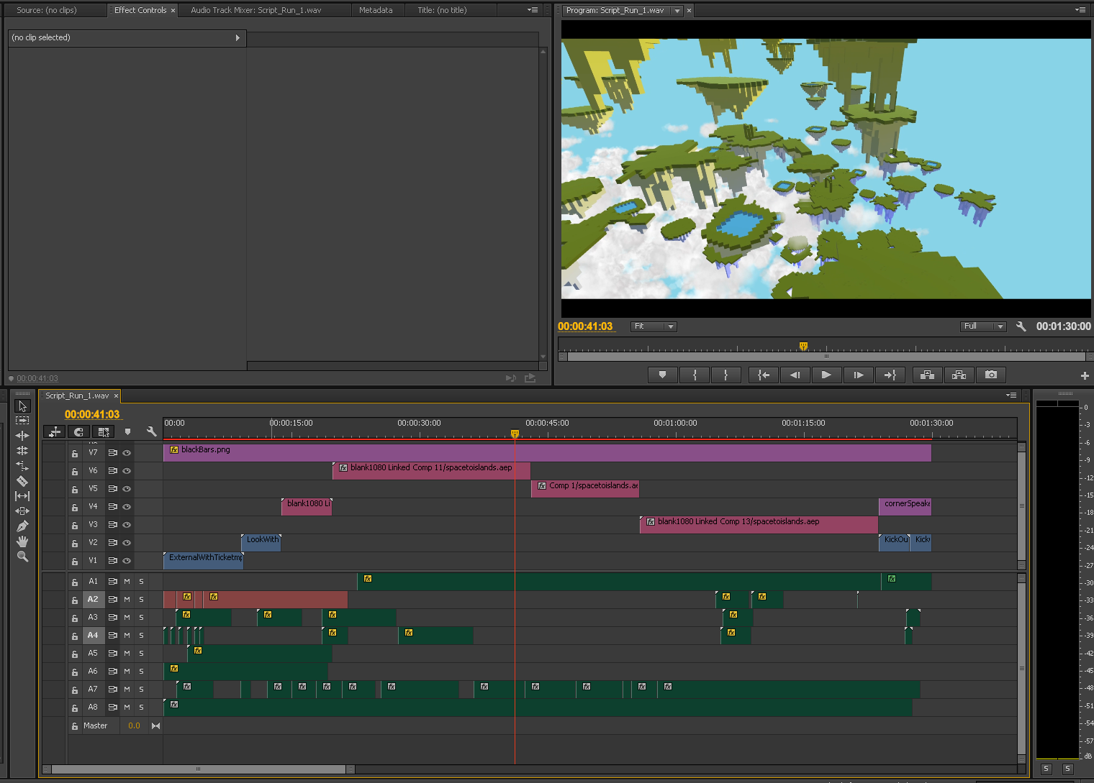
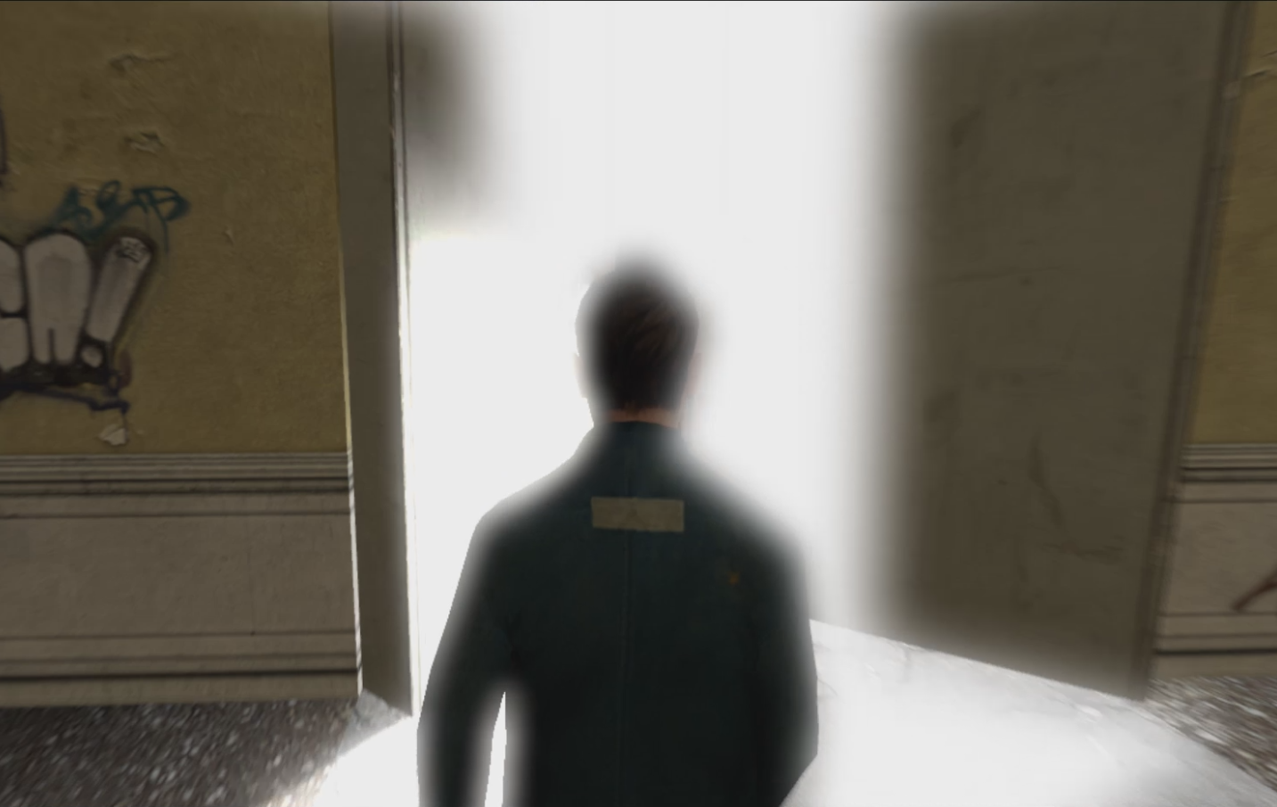
Editing
Cutting to non-diegetic sounds
Editing to match voiceover
Smooth transitions for camera cuts
Rotoscoping
Motion tracking & Visual effects

